Slide 1
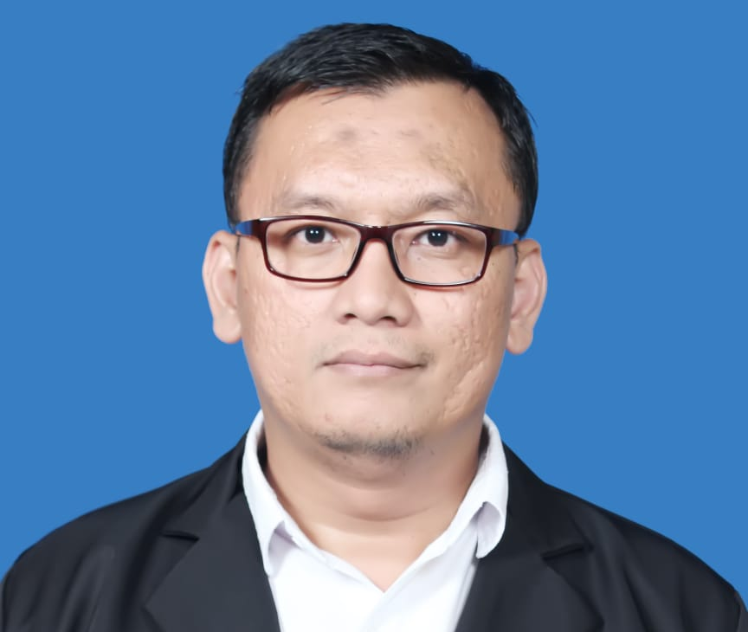



DICKY SURACHMAN
I have experience on IT field for more than 10 years, and most recently served as Corporate IT Manager for more than 5 years. I have abilities to develop software in desktop base, web base and mobile application base, also develop IT infrastructure such as Computer Networking, PABx, CCTV, server installation and backup systems. I have experience in implementing ERP, including warehousing system (Exceed, WM, AS400 and SAP B1), plantations (IES Nusantara) and hospitality (REALTA, VHP, Powerpro). I hope with my ability and experiences can help your company to achieve goals.
CONTACS
EXPERIENCES
Email
2017-Present | Corporate IT Manager on Intiwhiz International
Training IT knowledge on All IT staff Hotel
Solving all issue about IT and report to Management
Suggest IT Development and Strategy to Management
Preparing System and IT infrastructure for Opening Hotel such as Computer Networking, Server Installation, CCTV Installation, PABX Installation, and Backup System
Setup Mikrotik for Computer Networking on Hotels
Developing Hotel Management System for Capsule Hotel using PHP Yii Framework and MySQL
Developing Online Revenue Reporting System for Management
2014-2017 | Corporate Webmaster on Intiwhiz International
Developing and Maintains Booking Engine System for Hotel using PHP and MySQL
Developing and Maintains website for Corporate and Hotel using PHP and MySQL
Preparing digital campaign, using GDN, Facebook, Instagram, Mail Blast
Developing Live Chat System for Website using PHP and MySQL
Developing Mail Blast System for Digital Marketing using PHP and MySQL
Developing and Creating Loyalty Software for guest hotel (Whiz Mate) using PHP Yii Framework and MySQL
Developing Whiz Mate mobile application on App Store and Google Play Store using B4i and B4x
Interfacing API system Raiz-Gain Channel Manager with booking engine using PHP and MySQL
Interfacing payment gateway system (Midtrans, Doku, Reddot) with booking engine using PHP and MySQL
2013-2014 | IT Support on PT Cipta Tumbuh Berkembang
Preparing, planning and implementing for ERP System on Kelapa Sawit Company using IES Nusantara
Developing and maintenance website company
Developing PO System using PHP Yii Framework
Maintains WAN Infrastructure between Jakarta and Kalimantan company area
2010-2013 | IT Programmer on PT Wira Logistics
Developing Daily Reporting System with automatically email sending feature by Daily base for Company’s costumer using Visual Basic and Microsoft Access
Interfacing system from Company’s costumer System to warehouse system using .NET and SQL Server, such as Carrefour system, Coca Cola (AS 400), and Sari Roti (SAP)
Creating and Maintains Payroll System using .Net and SQL Server
Creating add on Revenue System from Warehouse System (Exeed and WM 9) using .NET and SQL Server
Developing Cargo System with SMS Gateway feature using Visual Basic and SQL Server
Implement and training Warehouse System
Developing online reporting warehouse system for Company’s costumer using PHP Yii Framework and MySQL
dicky.surachman1@gmail.com
Phone
Mobile: +62 896-4636-1091
Address
Perumnas I - Tangerang 15111
Web
dickysurachman.github.io
PERSONAL INFO
i
Gender: Male
Place/Date of Birth: Jakarta 8-Sept-1983
Religion: Islam
Blood Group: B
Marital Status: Married
EDUCATIONS
2001-2006 | Andalas University, Padang (Electrical Engineering)
2003-2004 Computer Laboratory Assistant of Technic Faculties Andalas University
1998-2001 | SMU Negeri 1, Tangerang
SKILL HIGHLIGHTS
Software:
PHP
ASP.NET
Microsoft Visual Basic 6.0
MySQL Server
SQL Server
Postgree SQL Server
Microsoft Access
Hardware:
Local Area and Wireless Network
Service and Maintenance Computer
Language:
Indonesia and English (active and passive)

Slide 2



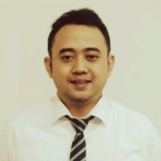
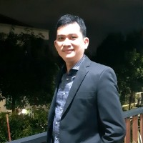
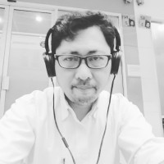
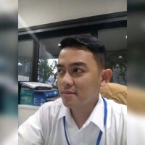
Projects
RECOMMENDATIONS From Linkedin
2021 | Kema Hotel Website Lead Developer for website development and Reservation Online System integrated Midtrans Payment gateway using PHP Laravel Framework and MySQL
2021 | Amoypreneur Web Developer for Developing website for personal and ecommerce business using PHP Yii Framework and MySQL
2020 | MWLogistics Web Developer for Developing Kurir System (creating qrcodesytem, invoicing, sale report, kurir system and warehouse system ) @ mwlogistics.com/kurir
2020 | Mujikaryautama Web Developer for Developing property agent and company website @ mujikaryautama.com
2019 | GRANDWHIZ MEGAMAS MANADO IT Project Manager for Hotel opening. Preparing all IT infrastructure, server installation, LAN and Internet Wireless Network, PABx, CCTV and Hotel Software
2018-2019 | WHIZ CAPSULE THAMRIN IT Project Manager for Hotel opening. Preparing all IT infrastructure , server installation, LAN and Internet Wireless Network, CCTV and Hotel Software
2017-2018 | WHIZ PRIME KHATIB SULAIMAN PADANG IT Project Manager for Hotel opening. Preparing all IT infrastructure , server installation, LAN and Internet Wireless Network, PABx, CCTV and Hotel Software
2017-2018 | ex. WHIZ PRIME MALIOBORO YOGYAKARTA
IT Project Manager for Hotel opening. Preparing all IT infrastructure , server installation, LAN and Internet Wireless Network, CCTV and Hotel Software
2017-2018 | WHIZ PRIME HOTEL SUDIRMAN MAKASSAR
IT Project Manager for Hotel opening. Preparing all IT infrastructure , server installation, LAN and Internet wireless Network, PABx, CCTV and Hotel Software
2017-2018 | WHIZ HOTEL FALATEHAH JAKARTA
IT Project Manager for Hotel opening. Preparing all IT infrastructure , server installation, LAN and Internet Wireless Network, CCTV, PABx and Hotel Software
2017-2018 | WHIZ PRIME BASUKI RACHMAT MALANG
IT Project Manager for Hotel opening. Preparing all IT infrastructure , server installation, LAN and Internet wireless Network, PABx, CCTV and Hotel Software
2017-2018 | WHIZ CAPSULE GRAND BROMO
IT Project Manager for Hotel opening. Preparing all IT infrastructure , server installation, LAN and Internet Wireless Network, PABx, CCTV and Hotel Software
2017 | WHIZ PRIME SUDIRMAN CILACAP
IT Project Manager for Hotel Opening. Preparing all IT infrastructure, server installation, LAN and Internet Wireless Network, PABx, CCTV and Hotel Software
2016 | WHIZ MATE APPLICATION
Web and Mobile Developer for developing loyalty system for web base and mobile application using PHP Yii Framework, MySQL, B4x and B4i
2014-2015 | BOOKING ENGINE INTIWHIZ.COM
Web Developer for developing booking engine for hotels under Intiwhiz Management using PHP and MySQL
2014-2015 | BOOKING ENGINE INTIWHIZ.COM
Web Developer for developing booking engine for hotels under Intiwhiz Management using PHP and MySQL
2014 | Cipta Tumbuh Berkembang Website
Web Developer for developing company profile Website using PHP and MySQL
2013 | Transport Management System Wiralogistics
Programmer for Developing transport management system base on SMS Gateway using Visual Basic and SQL Server
2012 | Cargo System Wiralogistics
Programmer of Cargo Management System with sms service feature using Visual Basic and SQL Server
Mr. Rachman is my favorite colleagues !! He is always available to help us when needed, he strives for excellence and is a valuable team player.
We worked together at Intiwhiz International and he helped me a lot to get started and also to understand internal processes.
He has the ability to work on multiple tasks and still be focused and deliver quality work. I can easily say he is one of the best in his field.
Ciaoo....
ANGGA YOKO ARDIANSYAH
Corporate Human Resources di PT Intiwhiz International
Helpful person
HAPOSAN SITUMORANG
General Manager Kaisar Hotel
best partner programming
WAHYU NURHIDAYAT
Dotnet Developer
Pak Rachman paling top dah urusan perITan. Sempet kolaborasi bikin system software yg simpel. Sukses terus pak.
REZA ANNAS M.
Chief Accounting di Allstay Hotel Semarang

Slide 3

Seminar & Awards
Huawei Training Participation Certificate : The Future of Mobile App Industry (Zoom) by Huawei on Feb 2022
Digital Transform and Security in Healthcare Industry (Webinar) by Cyberhub.id on Feb 2022
Advanced Security for Financial Transaction (Webinar) by Cyberhub.id on Feb 2022
Securing Your Data in Cloud Environment (Webinar) by Cyberhub.id on Feb 2022
Tantangan Terkini Transformasi Digital Sektor Publik di Indonesia (Webinar) by Cyberhub.id on Feb 2022
Cyber security for Safe, Reliable, Secure Industrial Control System (ICS) (OT) (Webinar) by Cyberhub.id on Feb 2022
Managing the Trust Gap Issues with the V-Key V-OS Family of Products (Webinar) by Cyberhub.id on Feb 2022
Cloud Security Standard & Framework (Webinar) by Cyberhub.id on Feb 2022
The Role of ICT in Strengthening National Critical Infrastructure (Webinar) by Cyberhub.id on Feb 2022
Storage dan Database di AWS (Webinar) by Dicoding Academy on Jan 2022
Cyber forensic and cyber defense (Zoom) by Institut Technology Tangerang Selatan on Oct 2021
Cyber Security and Hacking Technique (Zoom) by Institut Technology Tangerang Selatan on Sep 2021
Pelatihan Online: Tips Memasarkan Produk anda secara online di Platform e-Commerce by Gapura Digital Growth with Google Researcher on Aug 2021
JUARA FAVORIT SHIPPERHACK 2021
Shipperhack Innovation Events on Jun 2021
Memulai berkakir sebagai Programmer (webinar)
by Kulingoding on May 2021
PENGANTAR CLOUD COMPUTING DENGAN AWS
by Dicoding Academy on May 2021
WEBINAR DIGITAL SKILL
by ASIOTI, Kominfo, & Kemenperin RI on Apr 2021
ALIBABA CLOUD: CLOUD COMPUTING CERTIFICATE TRAINING
by Indonesia Cloud Computing Association on Mar 2021
MICROSOFT INNOVATION SUMMIT 2019
by Microsoft on 2019
HYBRID IT SUMMIT 2018: AUTONOMOUS DATA CENTER
by Hewlett Packard Enterprise on Apr 2018

Slide 4
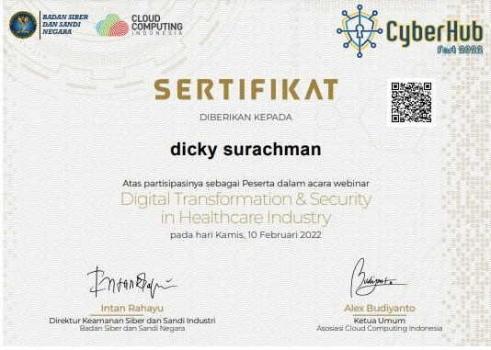
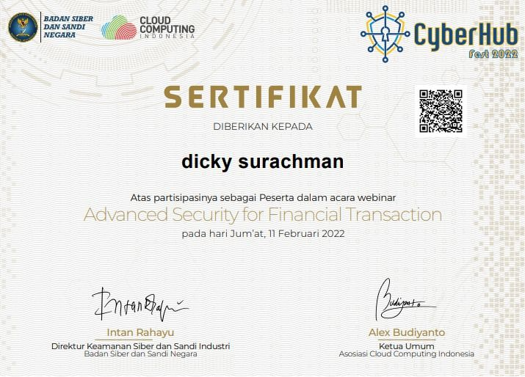
Seminar

Slide 5
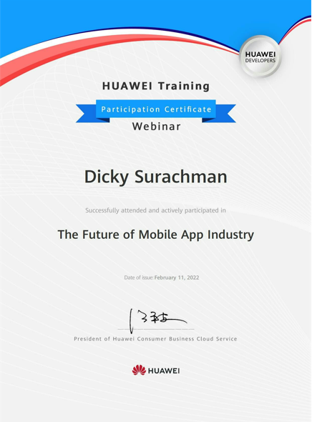
Seminar

Slide 6
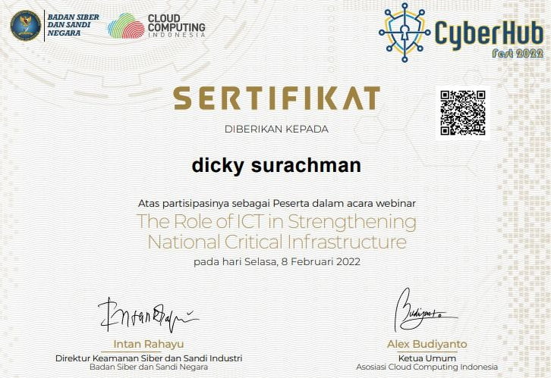
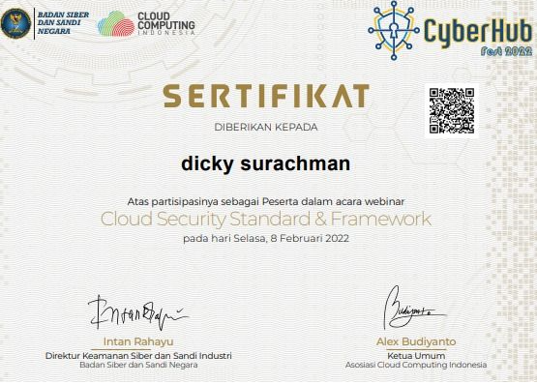
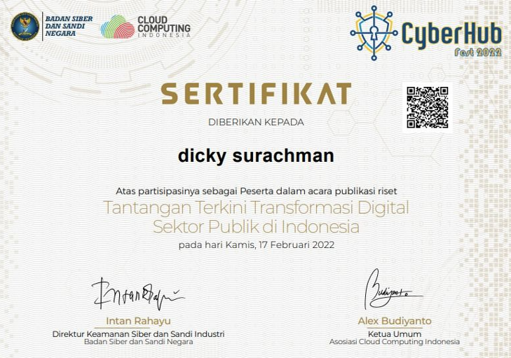
Seminar

